Slide 1

Major Project
Group D

Slide 2
Design Objectives
Our primary objectives for this project are as follows:
Create a technology to improve easy of use for modern supermarkets,
Implement a modular design to allow better scalability and maintenance.

Slide 3
Technology concept

Slide 4
Industry Need for Concept

Slide 5
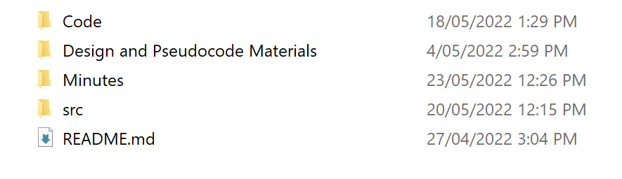
Documentation
Our project has been created and documented through GitHub:
Each group meeting has a minutes document
Project itself is outlined in README document.

Slide 6

Project Timeline
Scheduled timeline for project

Slide 7
Module Design
Our project has been split into five modules:
Serial module: handles error outputs, user queries and outputs corresponding messages
Sound & visual module: flashes and beeps corresponding to user distance from system
Status module: monitors orientation and acceleration of system
Object detection module: detects an object in front of the system
Tracking module: tracks position of object

Slide 8
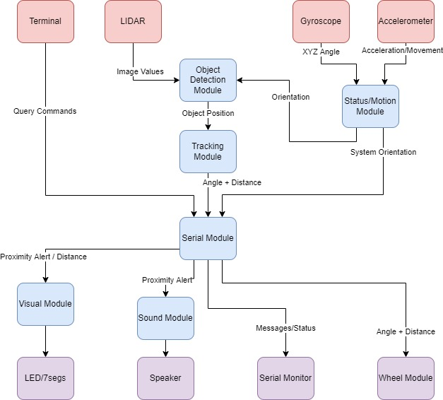
Module Interface and Free Body Diagram
Module | Inputs | Outputs
Serial Module | Queries User angle/distance Error messages | Error Messages Angle/distance
Audio/Visual Module | User distance | Sound/lights
Status Module | Gyroscope values Accelerometer values | System orientation System acceleration
Object Detection Module | LIDAR values System orientation | Object position
Object Tracking Module | Object position | User angle/distance

Slide 9
Roles and Responsibilities
Roles for this project were spread evenly among the group, with each member acting as the primary for one module.
Roles | Primary | Secondary | Support
Serial module | Will | Joon
Audio/visual module | Ethan
Status module | Joon
Object tracking module | Taj | Josh
Object detection module | Josh | Taj
Documentation | Will | Ethan

Slide 10
Serial Module PSEUdoCode
Serial Output
Function called
Load argument into buffer and end buffer with null
Update message to send bit/register to true
Check whether terminal ready to receive
If ready to receive, transmit character by character until null reached Update message to send bit/register to false
Clear buffer
Serial Input
If receive interrupt triggered
While message waiting to be received, read character by character into buffer
Update message to receive bit/register to false once null character received

Slide 11
AUDIO/Visual Module PseudoCode
Sound Module
Take in distance b/w cart and user (maybe via function call)
If user is too close beep
Beep at variable lengths based on distance
Visual Module
Take in distance b/w cart and user (maybe via function call)
Convert integer values to array of digits example:
(assumed max distance = 40m, therefore max digits = 2)
Distance = 2, array = [0, 2], displayed “02”
Distance = 13, array = [1,3], displayed “13”
Convert to seven seg values
Send to 7-seg display

Slide 12
Status Module PseudoCode

Slide 13
Object Detection PseudoCOde

Slide 14
Object Tracking PseudoCode

Slide 15
Technology Demonstration

Slide 16
Scalability and Further Development

Slide 17

Thank You
someone@example.com

